Slide 1
Diabetic prediction by : anuriya Raveendran on: 2/12/24

Slide 2
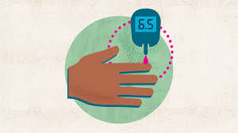
What’s diabetics?

Slide 3
AIM :
The aim of this project is predicting diabetes risk using the machine learning. We are using patient’s demographic and clinical features which includes the age , gender , insulin level , blood pressure etc .
This project will empower healthcare providers to make data-driven decisions, leading to earlier interventions and better patient outcomes in a healthier manner.

Slide 4
Problem statement :
The early diagnosis of diabetes is crucial for effective management and prevention.
However, manual analysis of patient data is time-consuming and prone to errors.
This project aims to automate and improve diabetes prediction accuracy using machine learning.

Slide 5
Scope :
Statistical Insights: Analyze the dataset to determine significant predictors of diabetes.
Visualization: Use graphs (e.g., count plot, box plots, and heatmaps) to convey relationships and distributions.
Public Health Initiatives:
Help governments or organizations target specific populations for diabetes prevention campaigns.
Monitor diabetes trends over time to evaluate the effectiveness of interventions.
Research:
Explore the interplay between lifestyle factors (e.g., smoking habits) and diabetes risk.
Study how comorbidities like hypertension and heart disease affect diabetes prediction.

Slide 6
Methodology :
Importing data and checking
Data Cleaning
Data preprocessing
Exploratory Data Analysis

Slide 7
DATA SET :

Slide 8
Data understanding:
No of rows : 100000
No of columns : 9
Data type : Integer, Float , Object

Slide 9
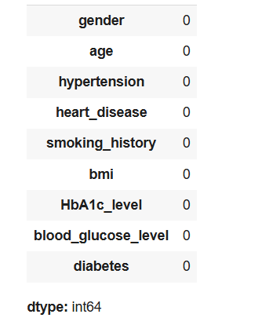
Exploration :
There is no missing values .

Slide 10
Code implementation :
Programming language : Python
Libraries :
EDA: Pandas, Matplotlib, Seaborn
Preprocessing: NumPy
Colab link : https://colab.research.google.com/drive/1L-ZindW-OaxGZMx0niw9vOBxYJ2jDoz-?usp=sharing

Slide 11
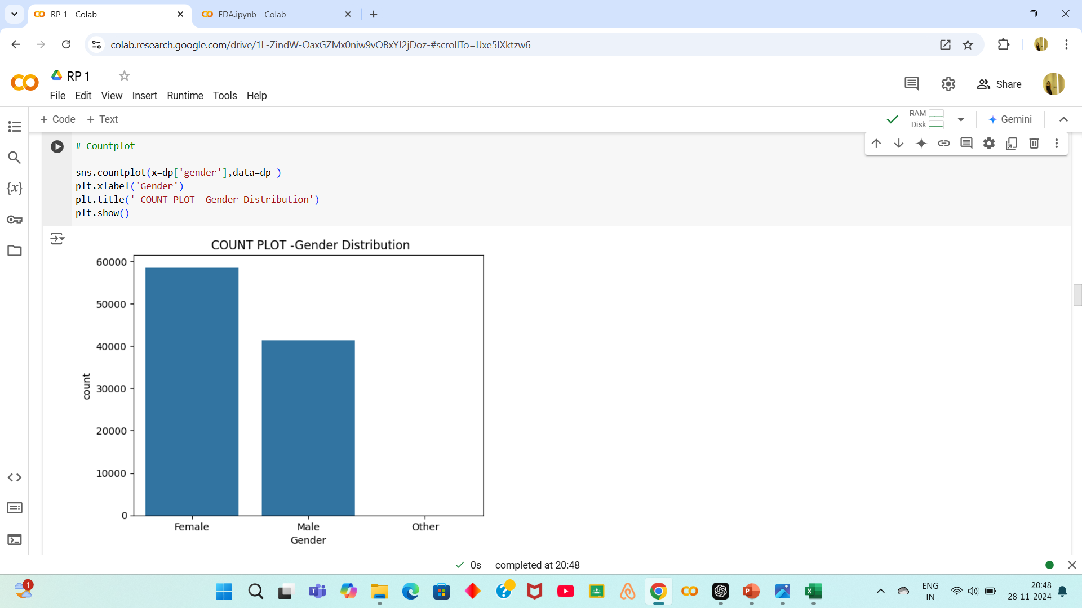
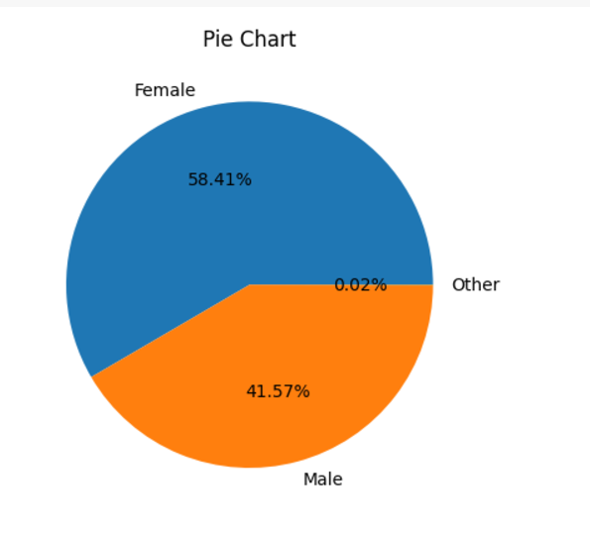
DATA VISUALIZATION :

Slide 12
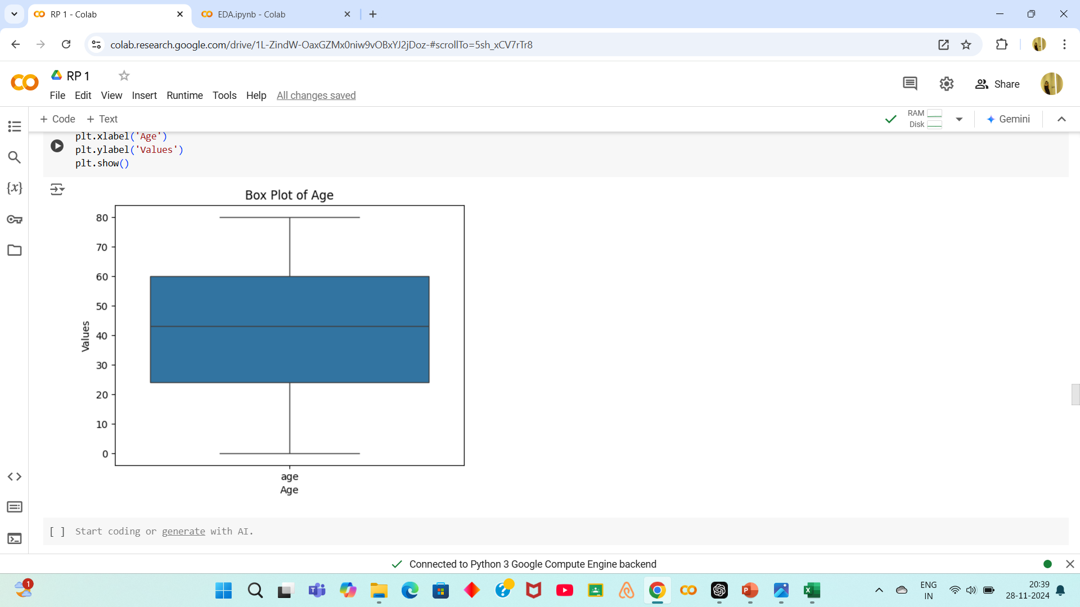
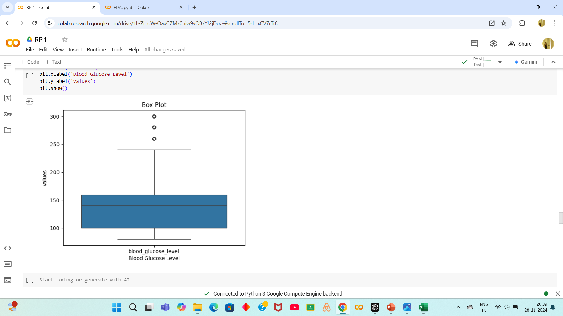

Slide 13
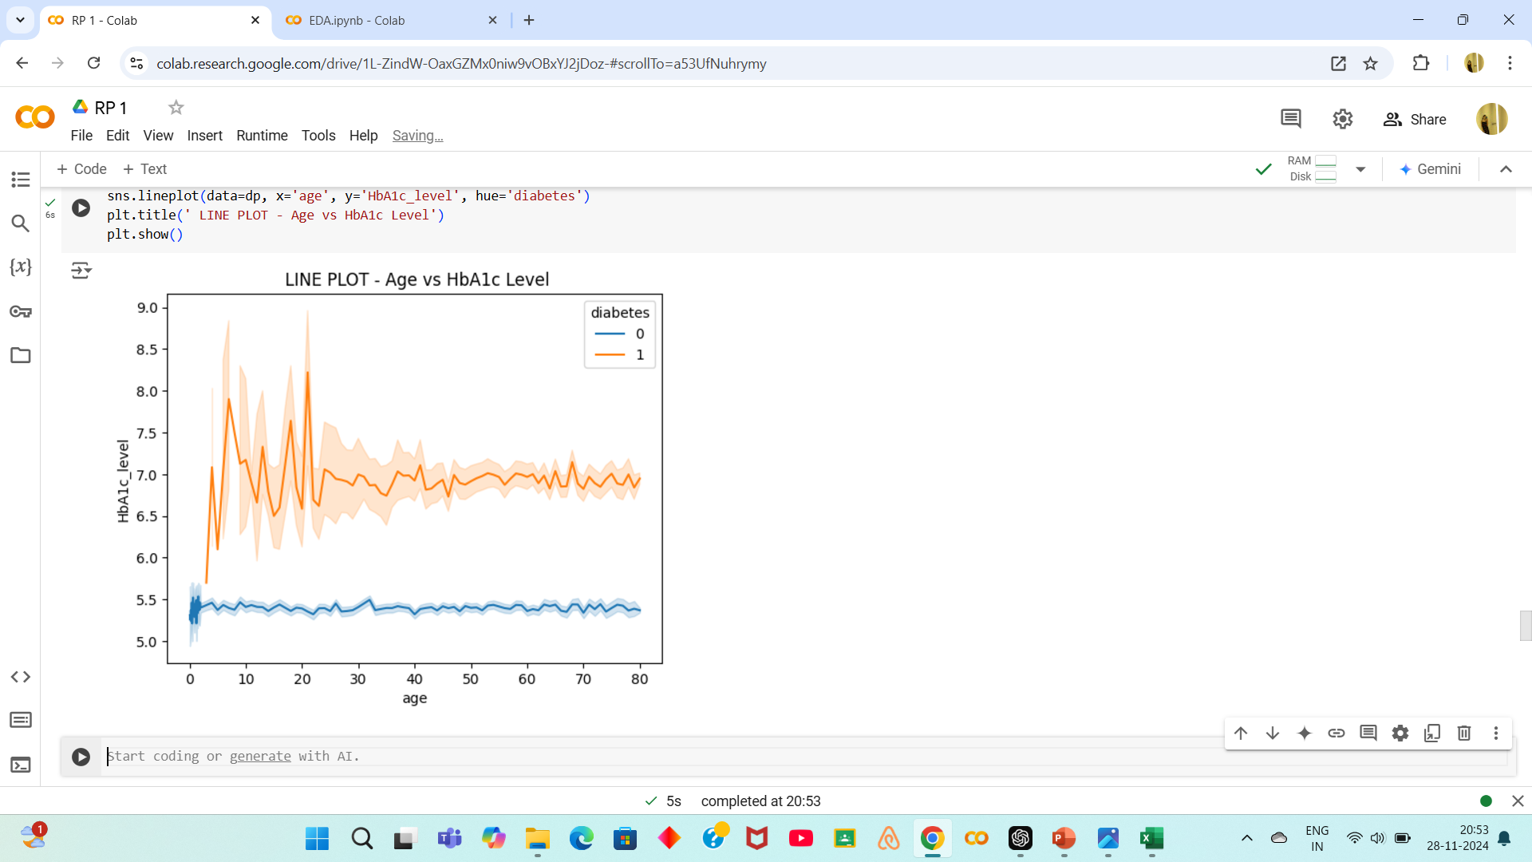
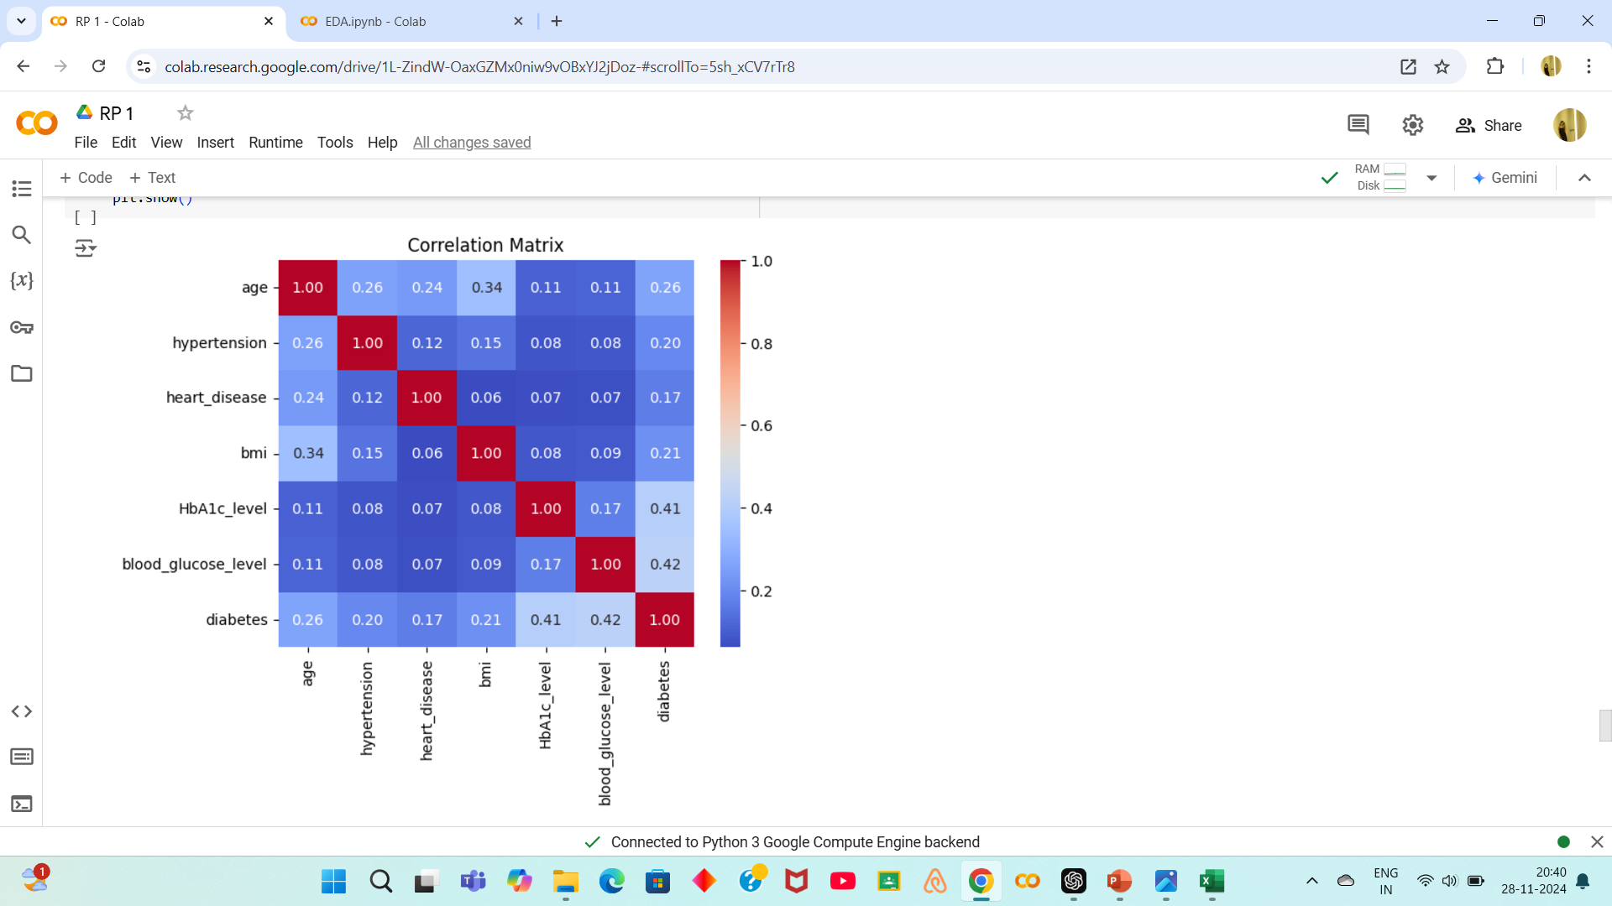

Slide 14
Results :
Key Features Correlation:
Features such as HbA1c_level and blood_glucose_level showed strong correlations with the target variable (diabetes).
Lifestyle factors like smoking_history and clinical conditions such as hypertension and heart_disease have weaker but still relevant associations with diabetics.
Feature Insights:
Age: The likelihood of diabetes increases with age.
BMI: Higher BMI is associated with an increased risk of diabetes, though there may be outliers to address.
Gender and Smoking History: These categorical features require further analysis, but they contribute additional context to diabetes prediction.

Slide 15
Conclusions :
Predictive Insights:
The dataset includes strong predictors of diabetes, particularly HbA1c_level, blood_glucose_level, and BMI. These features should be prioritized in predictive modeling.
Preprocessing Requirements:
The data is clean with no missing values but requires Outliers in features like BMI could skew predictions and should be carefully handled.
Applications:
The dataset can be effectively used to build machine learning models to predict diabetes.
Insights can guide healthcare providers in identifying at-risk individuals based on clinical and demographic features.

Slide 16
Thank you !

